Slide 1
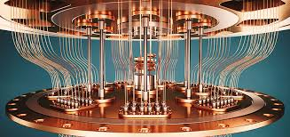

Particle Matching in Cyclic DEM Simulations based on Quantum Annealing
Group Members : Darren Lam Ming Hui,
Hasham Hussain, Pedro Videira, Xingguang Zhu
Advisor : Oliver Ahrend
Institute : Chair of Methods for Modelbased Developement in Computational Engineering

Slide 2
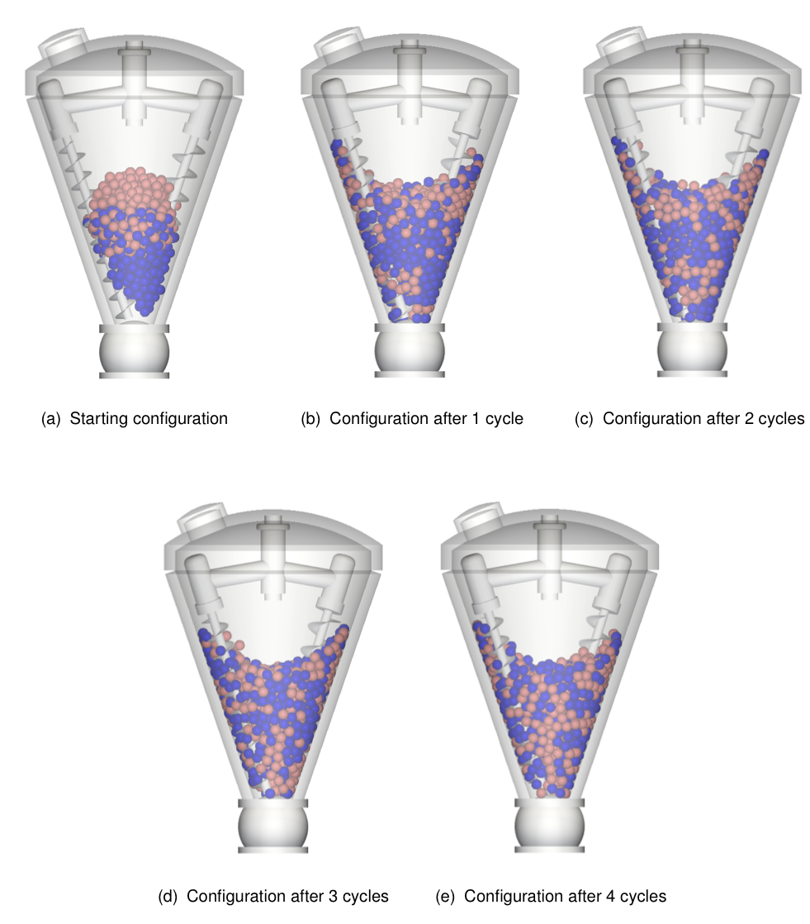
Short Description
Quantum Anneling speeds up cyclic particle simulations.
Assuming pure permutation per cycle.
Simulation data is retrieved from Discrete Element Simulations (DEM).
What is DEM ?
A type of numerical simulation technique.
A particle has physical properties e.g. shape, density
Darren Lam, Hasham Hussain, Pedro Videira, Xingguang Zhu | Particle Matching | 1

Slide 3
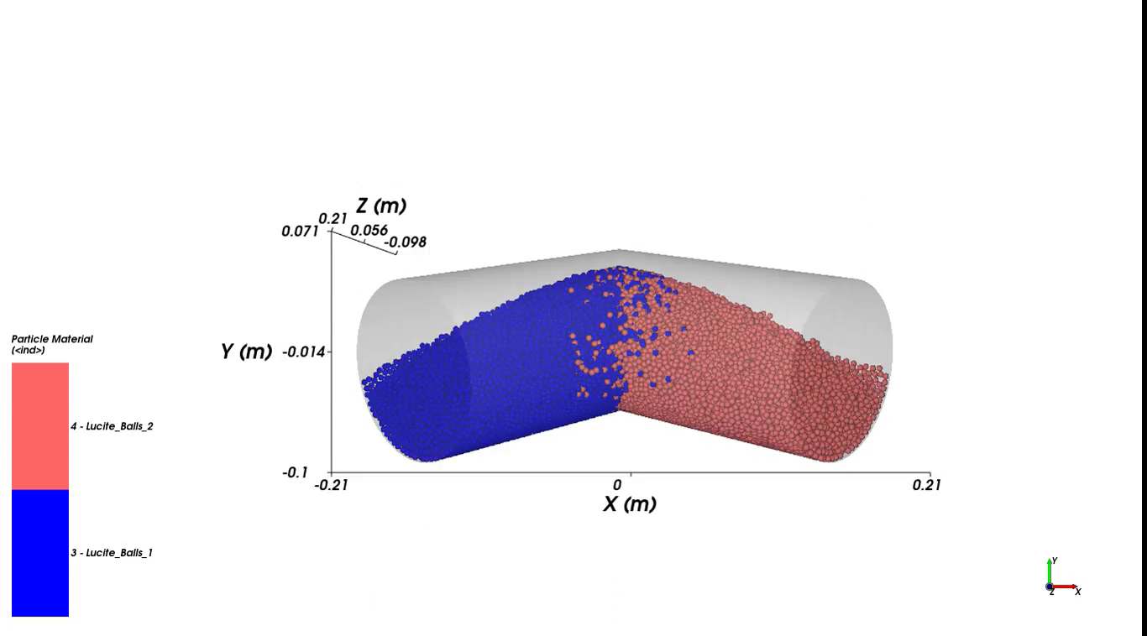
Video
Darren Lam, Hasham Hussain, Pedro Videira, Xingguang Zhu | Particle Matching | 2

Slide 4
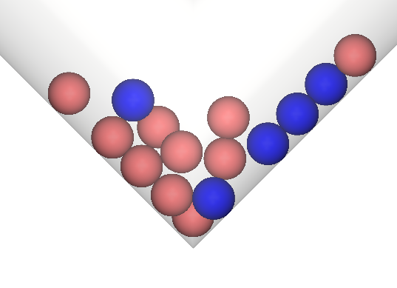
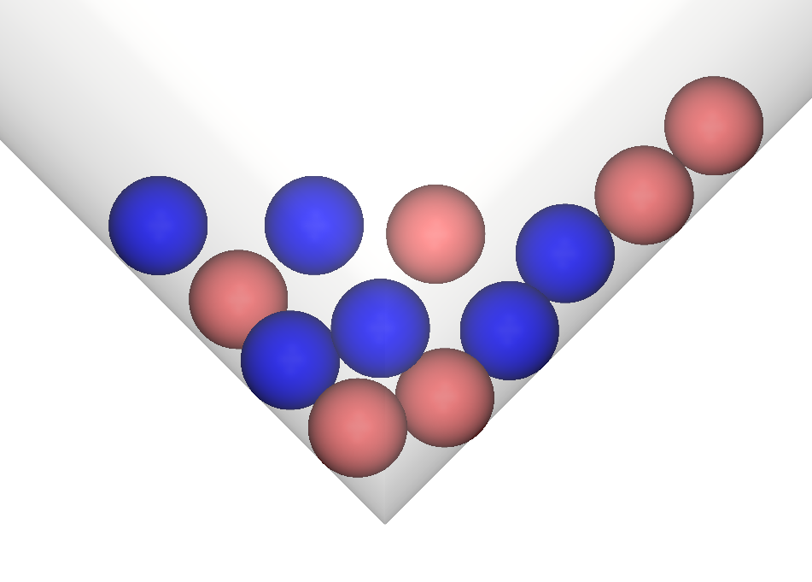
Motivations
Decrease computational time when simulating large mixing processes,
by exploiting cyclic behaviour.
Find permutation information by particle matching.
To assign future positions to particles.
After Rotation 24
After Rotation 25
1 cycle
3
2
1
3
2
3
2
1
1
Darren Lam, Hasham Hussain, Pedro Videira, Xingguang Zhu | Particle Matching | 3

Slide 5
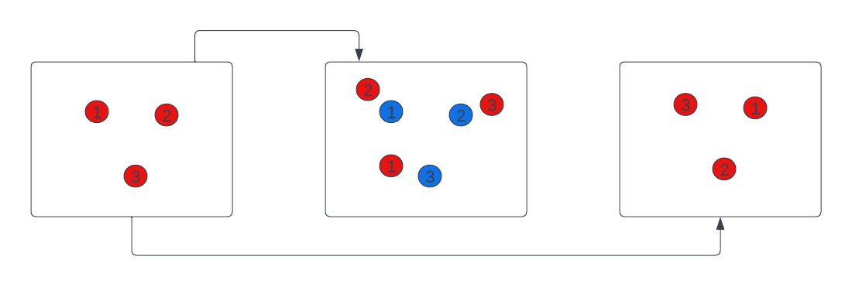
Assumptions
Perfect-Matching
n-cycle
(n+1)-cycle
(n+2)-cycle
Pure Permutation
old position (spot)
new position (particle)
all particles has same density, size, and rigid
In our case we assume that perfect-matching is a form of pure permutation
Perfect Matching ~ Pure Permutation
Darren Lam, Hasham Hussain, Pedro Videira, Xingguang Zhu | Particle Matching | 4

Slide 6
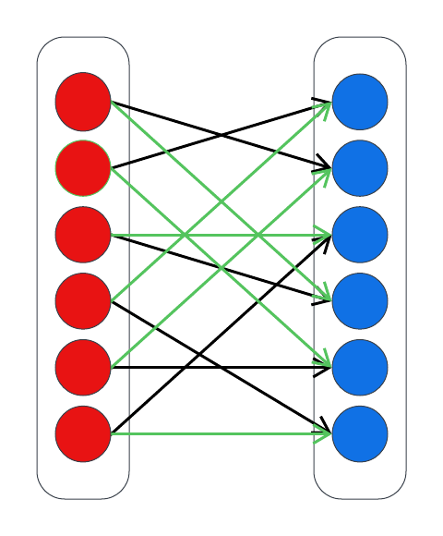
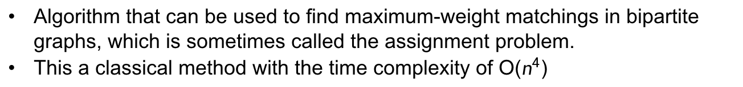
The Hungarian Method
Algorithm that can be used to find maximum-weight matchings in bipartite graphs, which is sometimes called the assignment problem.
This a classical method with the time complexity of O($n^{4}$)
old position (spot)
new position (particle)
Darren Lam, Hasham Hussain, Pedro Videira, Xingguang Zhu | Particle Matching | 5

Slide 7
Quantum Annealing
Problem
Definition
Formulation of Q matrix
Problem
Mapping
Quantum Annealing
Darren Lam, Hasham Hussain, Pedro Videira, Zhu Xing Guang | Particle Matching | MBD | 7

Slide 8
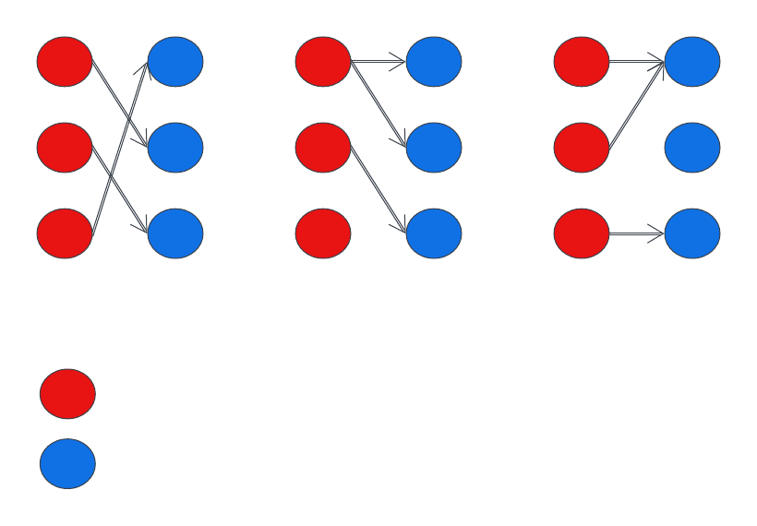
Quantum Annealing (Problem Definition)
Choosing number of particles to be n=3
Satisfies
Violates
Violates
New position (particle)
Old position (spot)
All matching must be a one-to-one relationship, otherwise it violates the constraints.
Darren Lam, Hasham Hussain, Pedro Videira, Xingguang Zhu | Particle Matching | 8

Slide 9
Quantum Annealing
Problem
Definition
Formulation of Q matrix
Problem
Mapping
Quantum Annealing
Darren Lam, Hasham Hussain, Pedro Videira, Zhu Xing Guang | Particle Matching | MBD | 9

Slide 10
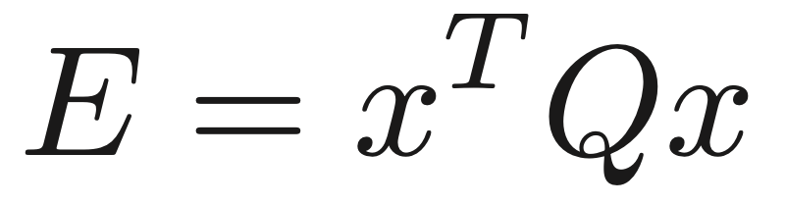
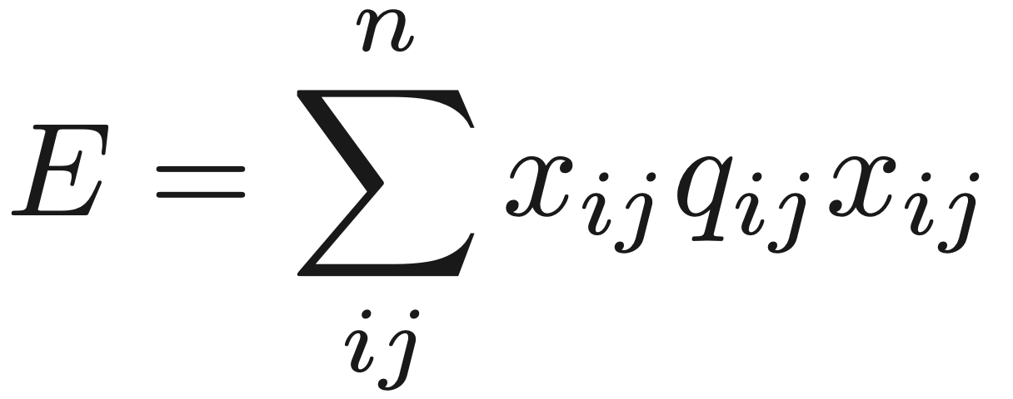
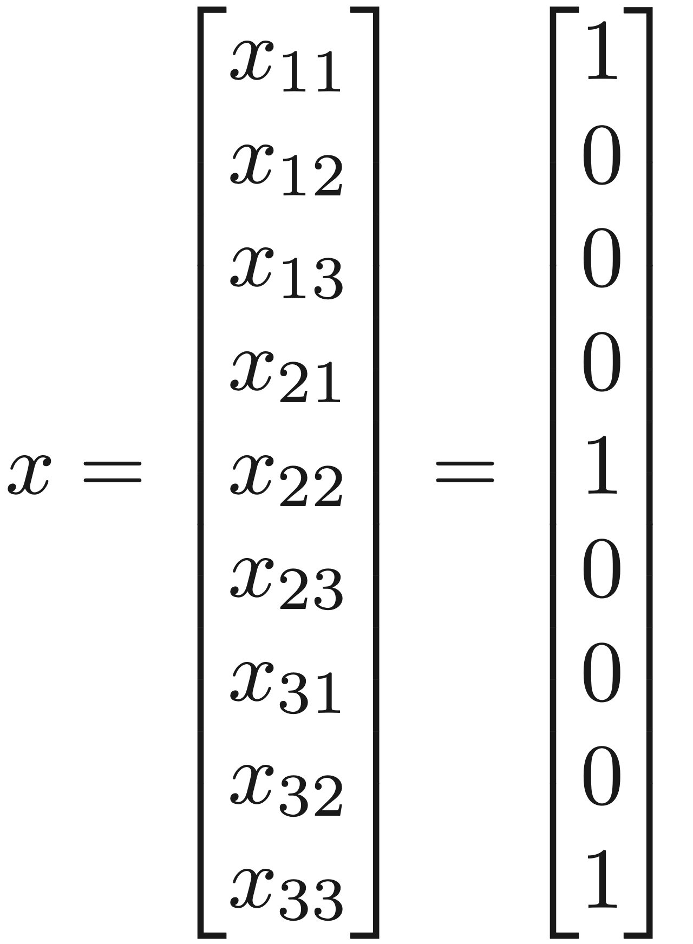
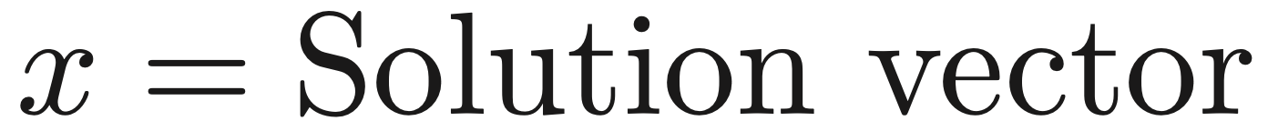

The Q-Matrix
Darren Lam, Hasham Hussain, Pedro Videira, Xingguang Zhu | Particle Matching | 10

Slide 11
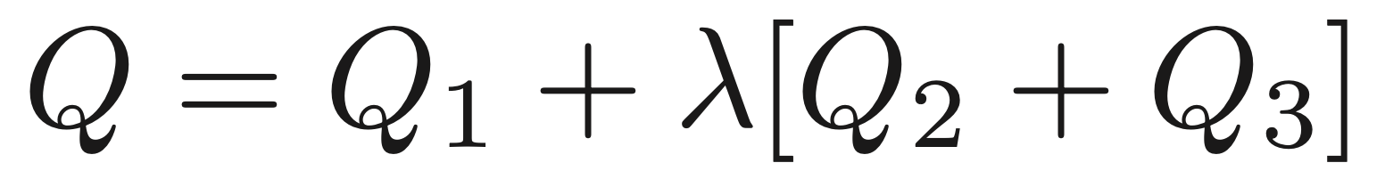
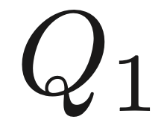
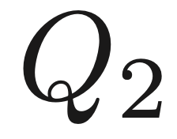
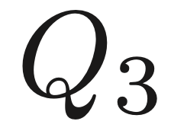

QA (Formulation of the Q Matrix)
Main part the problem is to combine all constraints into one Q-Matrix
Ensures the minimum distance between particle to spot.
Makes sure that all particles is matched to one spot.
Makes sure that all spot is matched to one particle.
Penalty coefficient
Darren Lam, Hasham Hussain, Pedro Videira, Xingguang Zhu | Particle Matching | 11

Slide 12
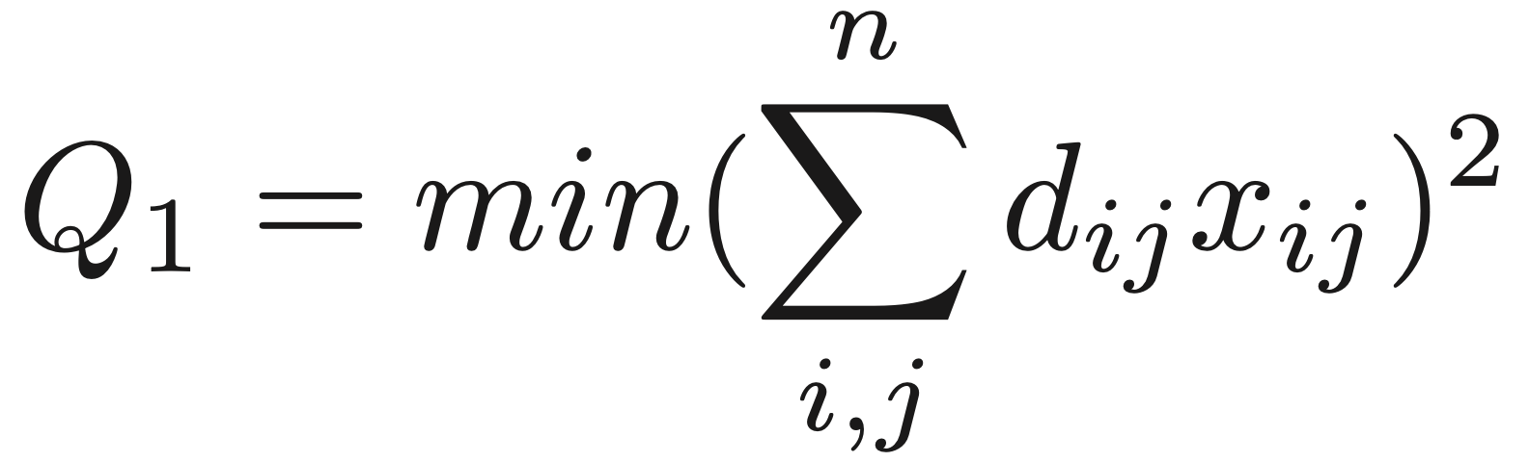
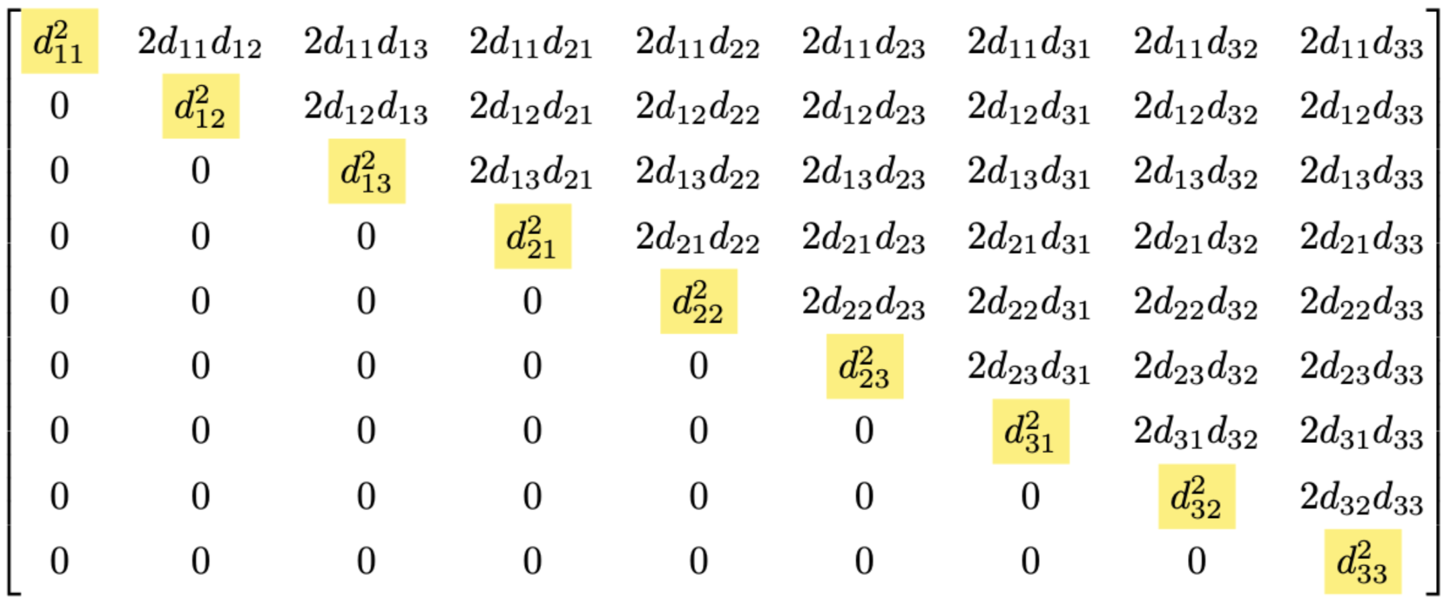
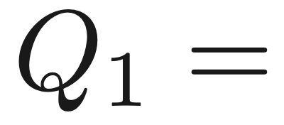
QA (Formulation of the Q Matrix)
for n=3,
Darren Lam, Hasham Hussain, Pedro Videira, Xingguang Zhu | Particle Matching | 12

Slide 13
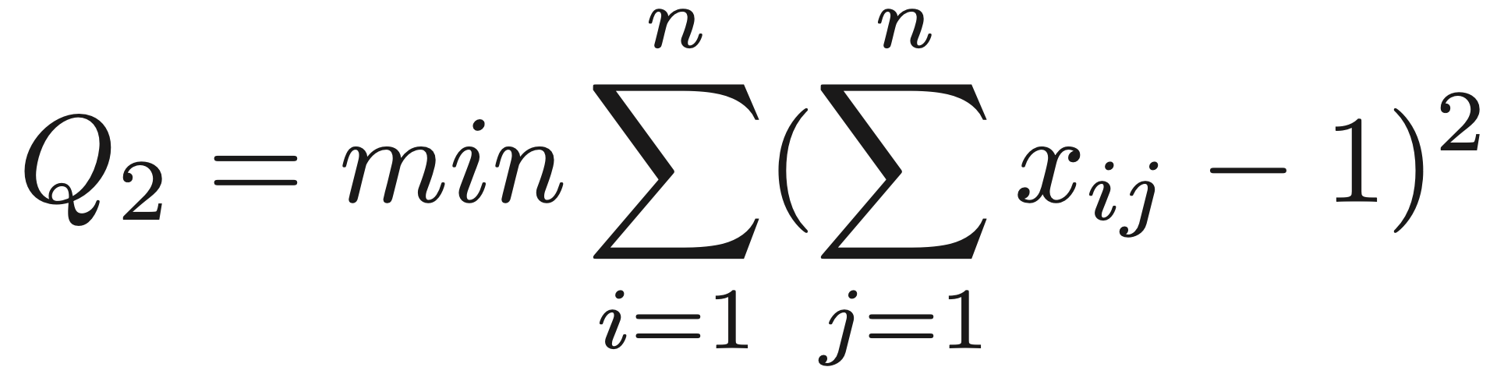
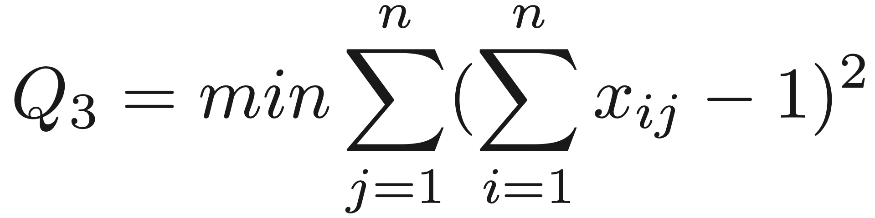
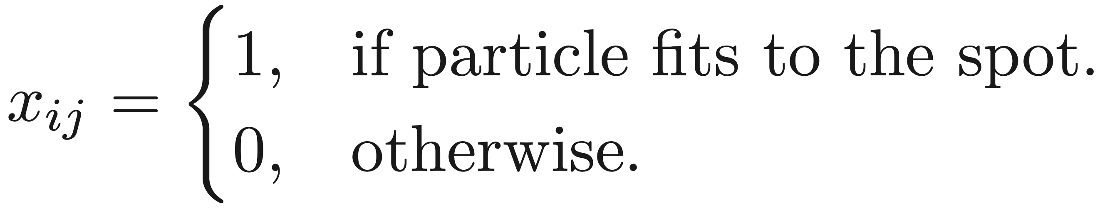
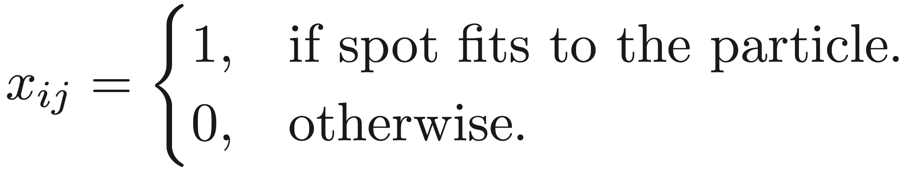
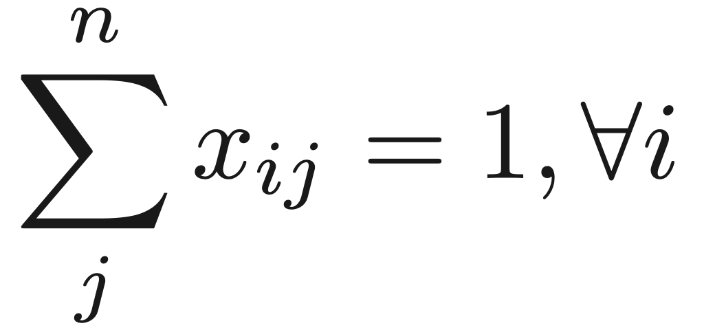
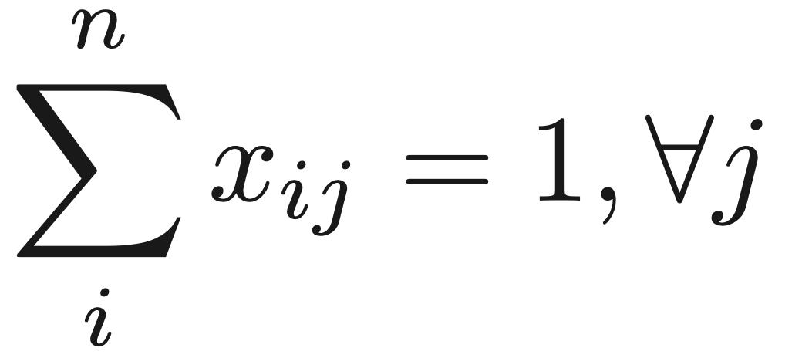
QA (Formulation of the Q Matrix)
It minimises the combination of particles(i) to spot(j)
It minimises the combination of spot(j) to particles(i)
Darren Lam, Hasham Hussain, Pedro Videira, Xingguang Zhu | Particle Matching | 13

Slide 14
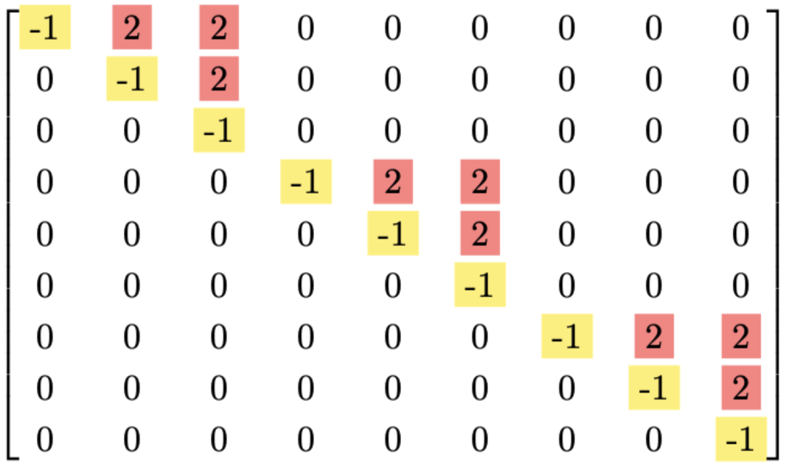
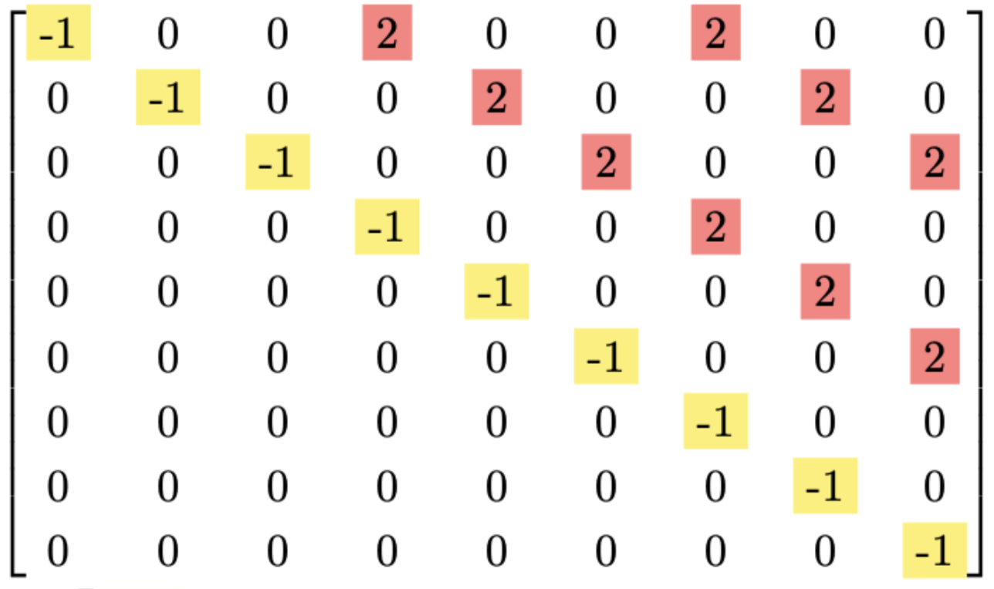
QA (Formulation of the Q Matrix)
for n=3,
Darren Lam, Hasham Hussain, Pedro Videira, Xingguang Zhu | Particle Matching | 14

Slide 15
Quantum Annealing
Problem
Definition
Formulation of Q matrix
Problem
Mapping
Quantum Annealing
Darren Lam, Hasham Hussain, Pedro Videira, Zhu Xing Guang | Particle Matching | MBD | 15

Slide 16
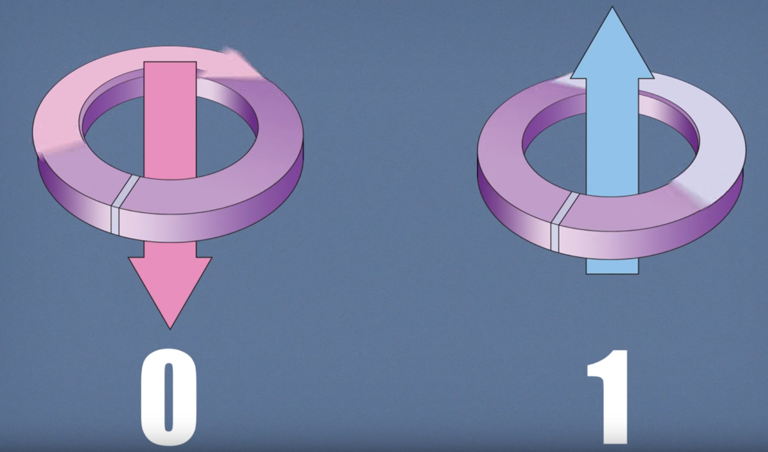
What is a Qubit?
[1]
Fundamental building blocks to perform quantum computation.
Can exist in superposition of 1 and 0.
[1] Copyright : https://docs.dwavesys.com/docs/latest/c_gs_2.html
Darren Lam, Hasham Hussain, Pedro Videira, Xingguang Zhu | Particle Matching | 16
Notes:
Before we get to the hardware implementation of the D’wave system, let’s define what a Qubit it.
Just like a binary bit is the basic unit of information in the classical computation, a Qubit is the basic unit of information for the quantum computation. But unlike a Bit which can only be 0 or 1, the qubit is can also be in a superposition of both 0 and 1.
In D-Wave's quantum annealing systems, qubits are implemented using superconducting loops of wire called flux qubits. These qubits are made from superconducting materials that exhibit quantum behavior when cooled to extremely low temperatures, close to absolute zero.

Slide 17
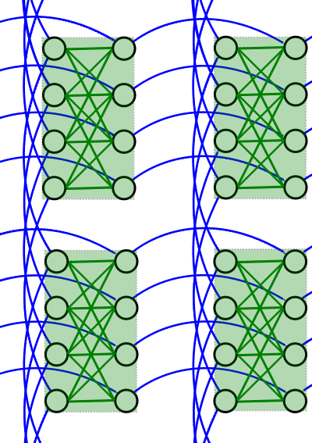
Chimera Architure
Overview
Designed for quantum annealing.
A 2D lattice structure
Unit Cell
Basic building block of the architecture.
Contains 8 interconnected qubits.
Qubit Connection
Each qubit connected up to 6 neighboring qubits within the unit cell.
Provides local interactions.
[2]
[2] Copyright : https://docs.dwavesys.com/docs/latest/c_gs_4.html
Darren Lam, Hasham Hussain, Pedro Videira, Xingguang Zhu | Particle Matching | 17
Notes:
D-wave systems has three architectures – Chimera, Pegasus and Zephyr. All of these architectures are laid on a 2D grid and are designed for quantum annealing.
Here we have a diagram of the Chimera Architecture. In this architecture we have cells containing eight qubits that have this bipartite connection. These cells are further connected to other identical cells as shows here with blue connections.

Slide 18
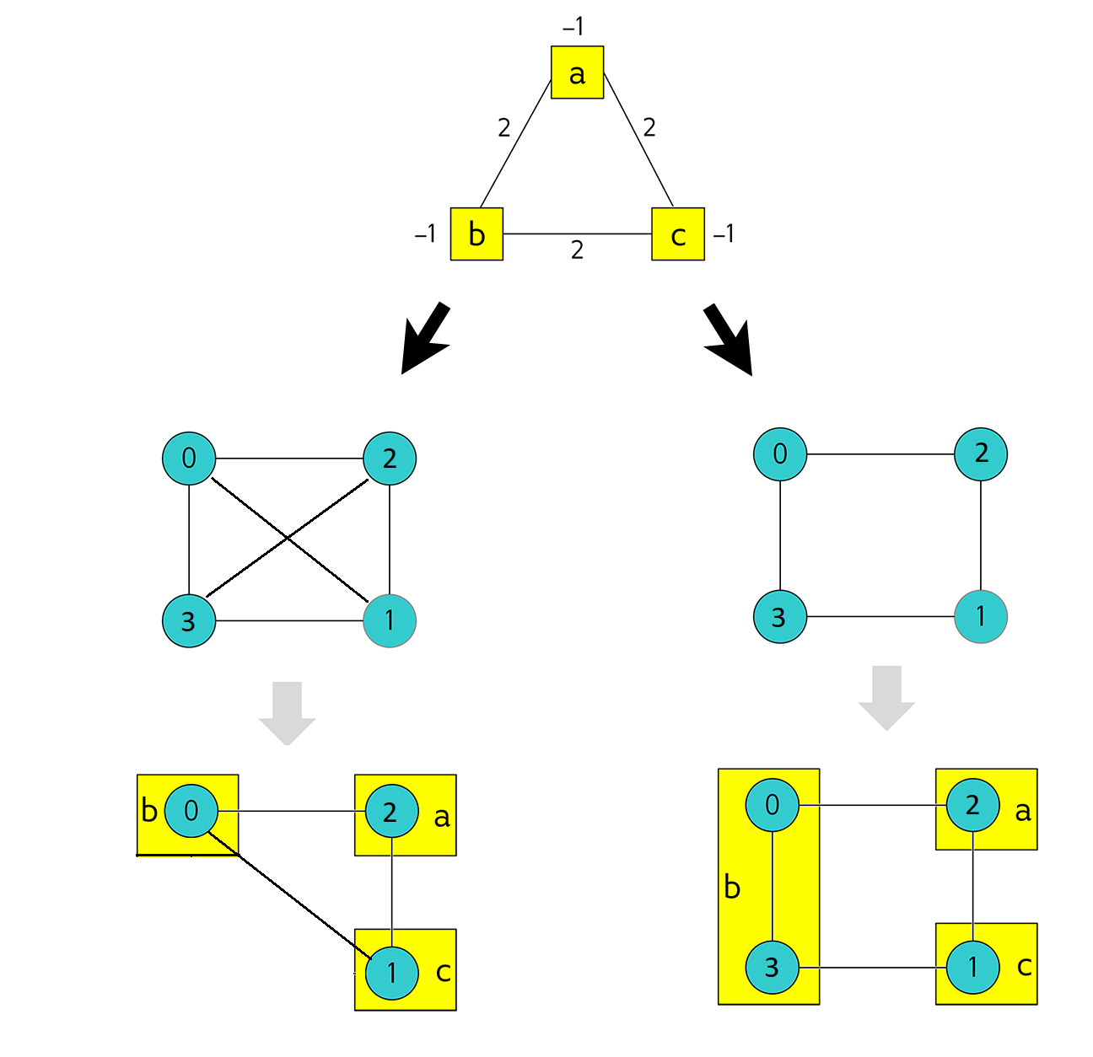
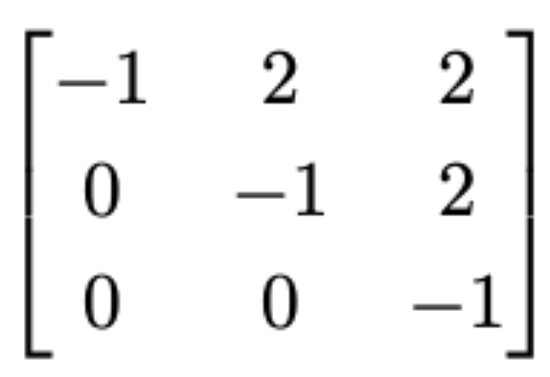
From Physical Qubits to Logical Qubits
Purpose : To increase the number of coupling
[3]
[3] Copyright : https://docs.dwavesys.com/docs/latest/c_gs_7.html
Darren Lam, Hasham Hussain, Pedro Videira, Xingguang Zhu | Particle Matching | 18
Notes:
Here we show how a q matrix is mapped to the 2-d grid of the annealer. Say you have a Q matrix with -1s in the diagonals and 2 on the off-diagonals in the upper triangular matrix. So, to map this, we need an arrangement of qubits as such. Now, if you have a structure of qubits like this where all the qubits are maximally connected then we can map this arrangement easily like this.
But now on a more realistic case, we would have a structure like that where these connections are missing. So to achieve this mapping we need to chain these two qubits together.
Chaining means that these two qubits are entangled now and they will have the same value.
Incidentally, we call this a logical qubit and these are the physical qubits.

Slide 19
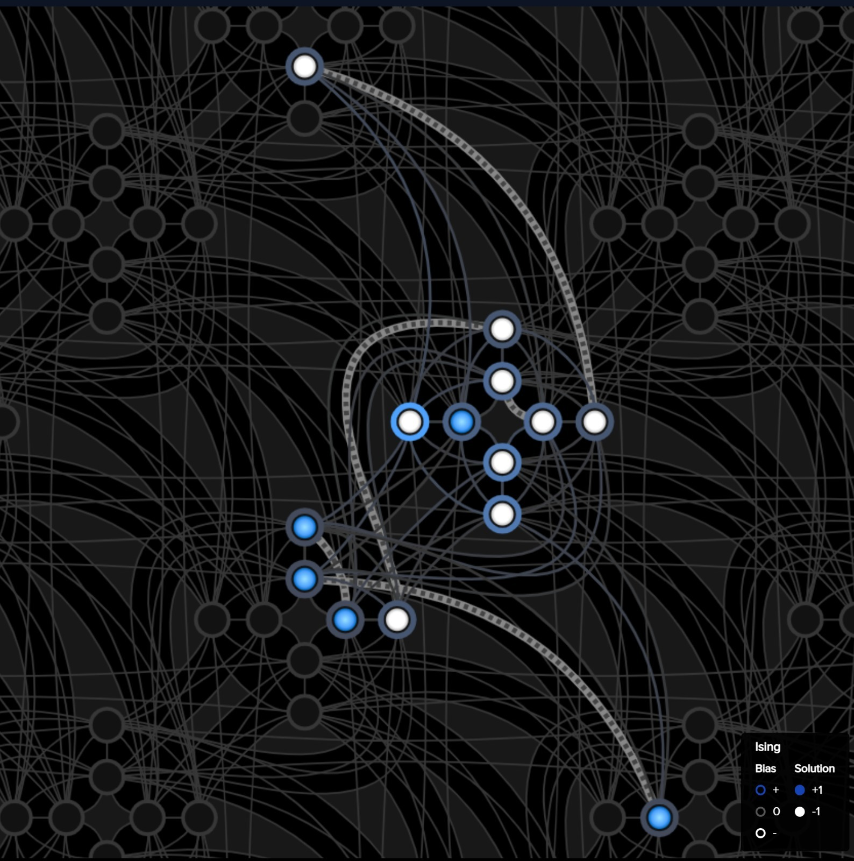
From Physical Qubits to Logical Qubits
Chains for 3 particles simulation
Darren Lam, Hasham Hussain, Pedro Videira, Xingguang Zhu | Particle Matching | 19
Notes:
For illustrative purpose, here we taken 3 particles in the simulation and get a Q matrix out of it. This Q matrix will have 9x9 entries and we would need 9 fully connected Qubits to map it to the hardware. But D-wave doesn’t have 9 fully connected Qubits. So we have to get clever and chain some of the qubits together. Here these white curves show that these qubits are chained now, so we can achieve a fully connected system that we need for our implementation of the problem.

Slide 20
Quantum Annealing
Problem
Definition
Formulation of Q matrix
Problem
Mapping
Results
Darren Lam, Hasham Hussain, Pedro Videira, Zhu Xing Guang | Particle Matching | MBD | 20

Slide 21
Results
Comparison of 4 methods
Particles | scipy.optimize.linear_sum_assignment()/seconds | Hungarian method/seconds | Simulated Annealing/ seconds | Quantum Annealing/ seconds
6 | 0.03 | 0.006 | 6.03 | 0.148
10 | 0.003 | 0.04 | 56.1 | x
30 | 0.002 | 0.001 | 6.735 | x
100 | 0.003 | 0.02 | - | x
300 | 0.004 | 0.2 | - | x
3,000 | 0.4 | 715.8 | - | x
12,000 | 7.5 | cancelled after 2 hours | - | x
17,000 | 22.7 | - | - | x
Darren Lam, Hasham Hussain, Pedro Videira, Xingguang Zhu | Particle Matching | 21
Notes:
Here we have the number of particles, this is the time it took in seconds to run the different implementations. This is the an efficient implementation of the Hungarian method, this is the classic Hungarian method. Here is a simulated version of the annealing process that we can do a normal classical computer. And finally here we have the quantum implementation of the annealing process.

Slide 22
Results
Assuming all qubits has full 6 couplings/connections and ideal chaining.
Q-Matrix is densely populated.
Particle | Dimension | Qubits per Chain | Physical Qubits
6 | 36 | 8 | 288
7 | 49 | 10 | 490
8 | 64 | 13 | 832
9 | 81 | 17 | 1377
10 | 100 | 20 | 2000
Darren Lam, Hasham Hussain, Pedro Videira, Xingguang Zhu | Particle Matching | 22
Notes:
ou can see that this implementation of the Hungarian method works the best. And with the current hardware limits on the D-wave’s system and also because of the way we have formulated our problem we were only able to reliably run the computation for only six particles.
Here are some thought experiments so show the number of physical qubits we would need to have to run the simulation for these many particles. Here we postulate that with the current implementation the number of physical qubits grows rapidly. Already you can see that with only 10 particles we are reaching the limits of the number of qubits. Also here is the number of chains we would need…

Slide 23
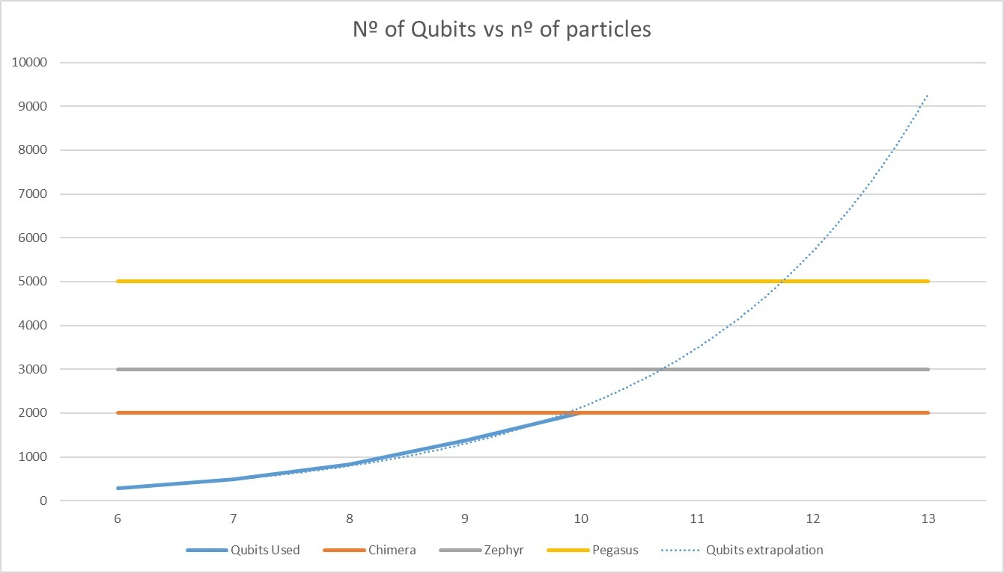
Results
Darren Lam, Hasham Hussain, Pedro Videira, Xingguang Zhu | Particle Matching | 23
Notes:
Here we see the rapid growth in the number of required qubits.

Slide 24
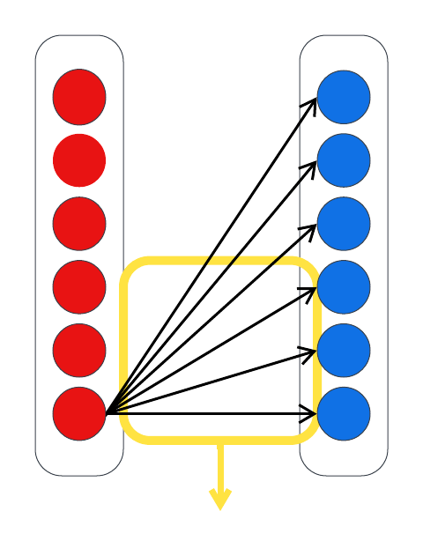
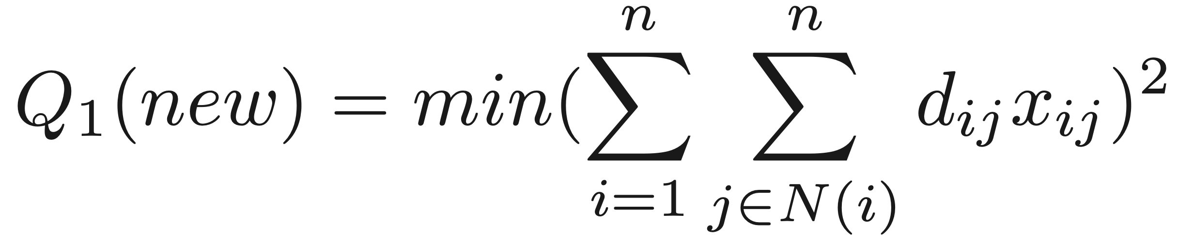
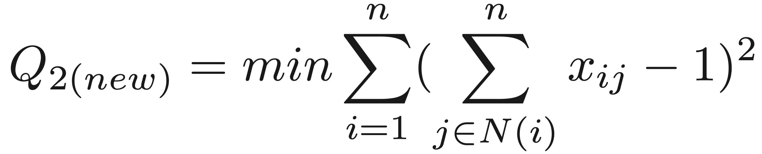
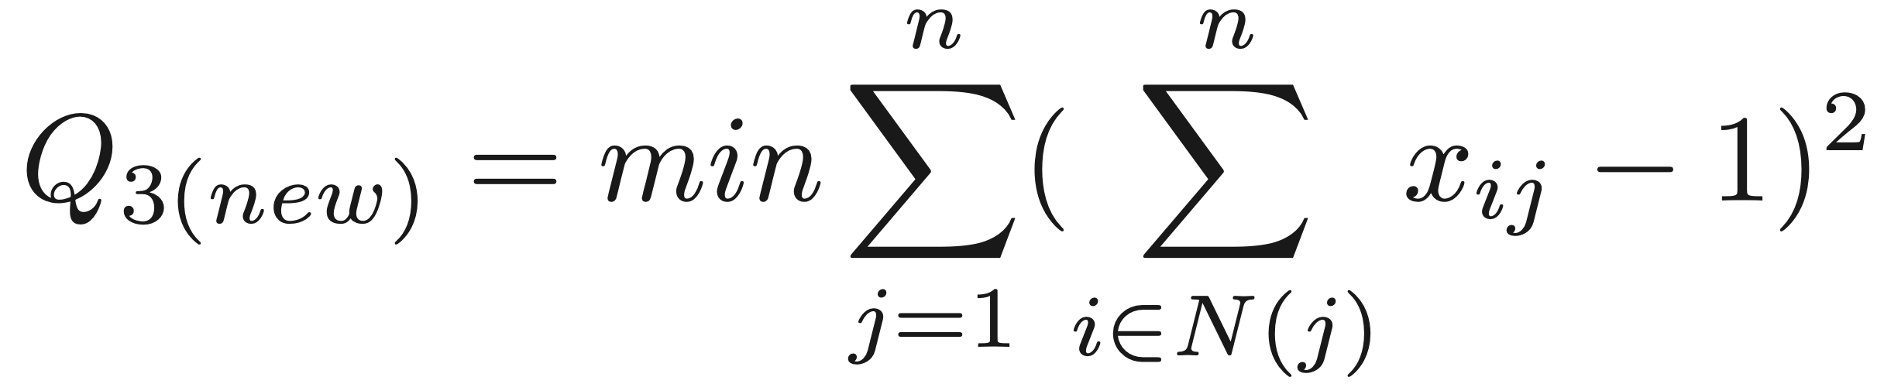
Future Work
Modify Q-Matrix
Set N
Darren Lam, Hasham Hussain, Pedro Videira, Xingguang Zhu | Particle Matching | 24

Slide 25
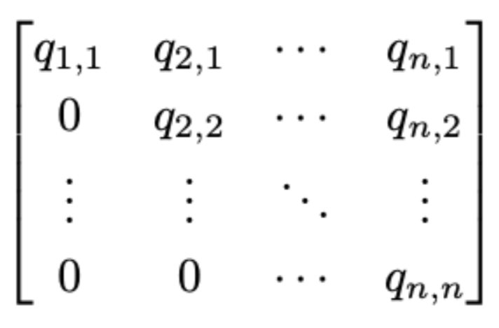

Future Work
Modify Q-Matrix
Removing some row(s) and column(s)
Reducing the size of the Q- Matrix
Darren Lam, Hasham Hussain, Pedro Videira, Xingguang Zhu | Particle Matching | 25

Slide 26
Conclusion
We have came up with a robust algorithm.
Due to hardware limitation with Quantum Computers,
we need to reduce the size of Q-Matrix.
Darren Lam, Hasham Hussain, Pedro Videira, Xingguang Zhu | Particle Matching | 26
"In conclusion, we now have robust algorithms at our disposal, and simulated annealing has substantiated its efficacy. However, when it comes to actual quantum annealing, due to hardware limitations, we are currently unable to achieve the same level of implementation.

Slide 27
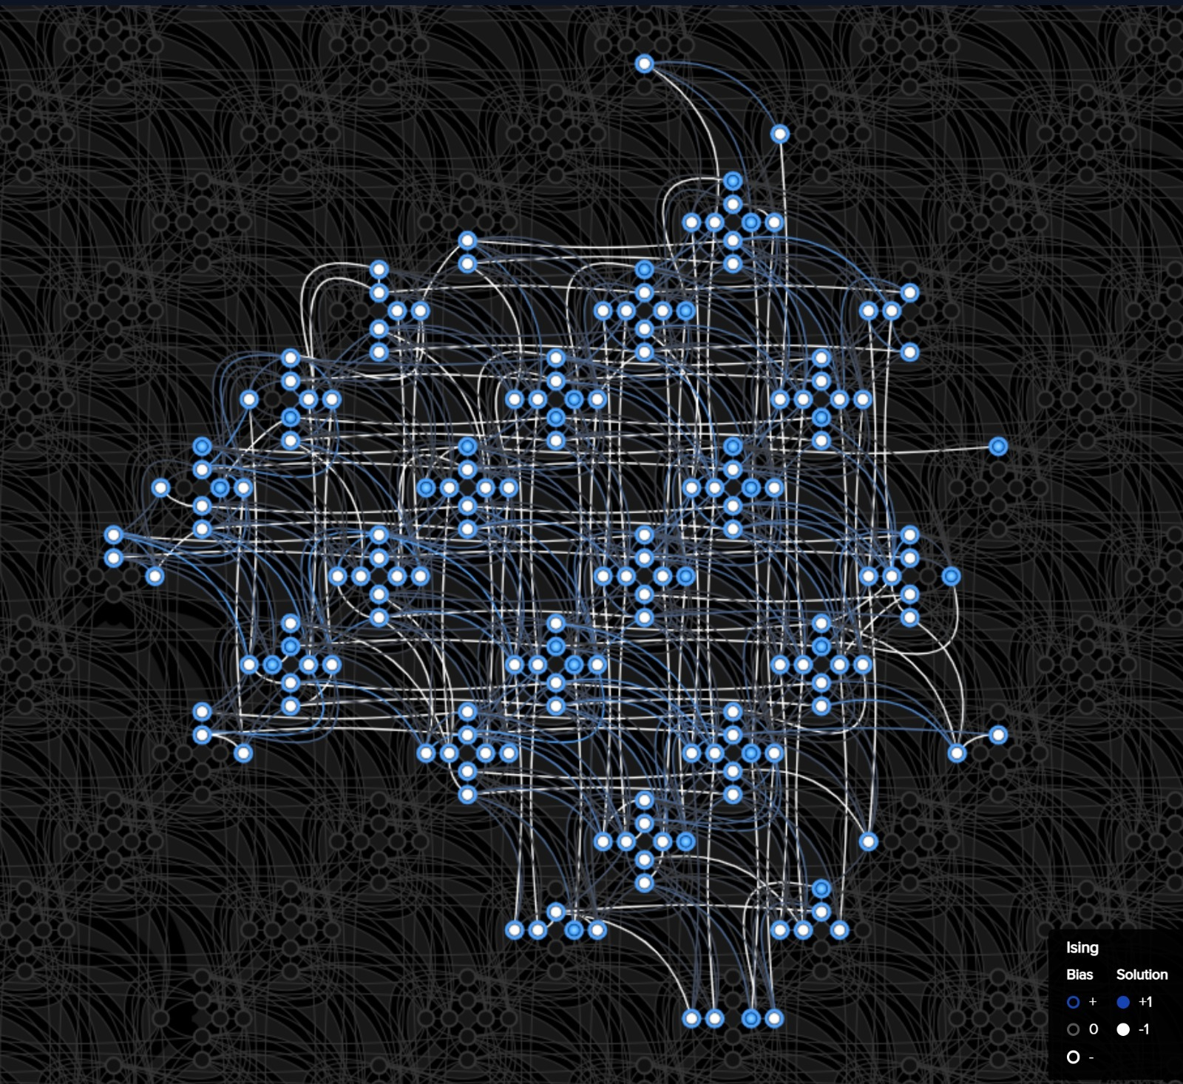
The End
D-Wave Inspector Tool (for n=6)
Darren Lam, Hasham Hussain, Pedro Videira, Xingguang Zhu | Particle Matching | 27

Slide 28
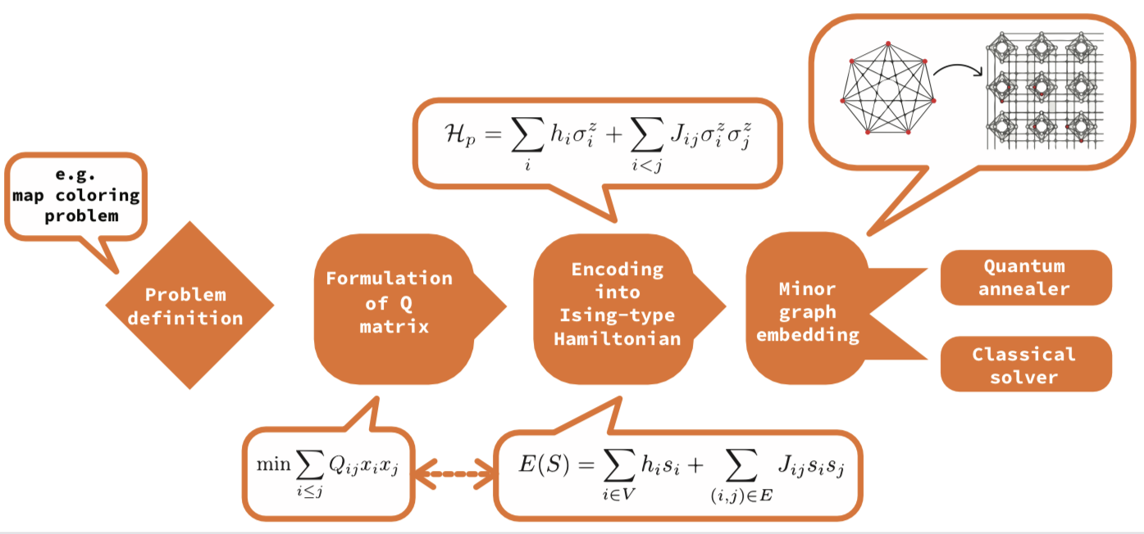
Darren Lam, Hasham Hussain, Pedro Videira, Xingguang Zhu | Particle Matching | 28

Slide 29
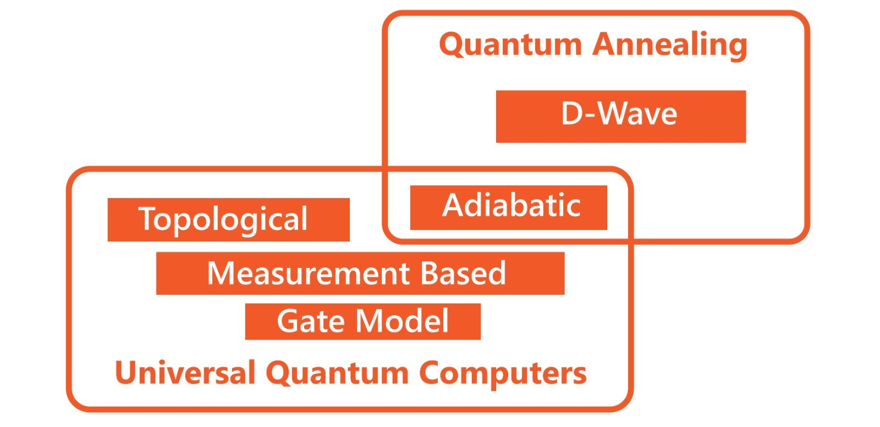
Darren Lam, Hasham Hussain, Pedro Videira, Xingguang Zhu | Particle Matching | 29

Slide 30
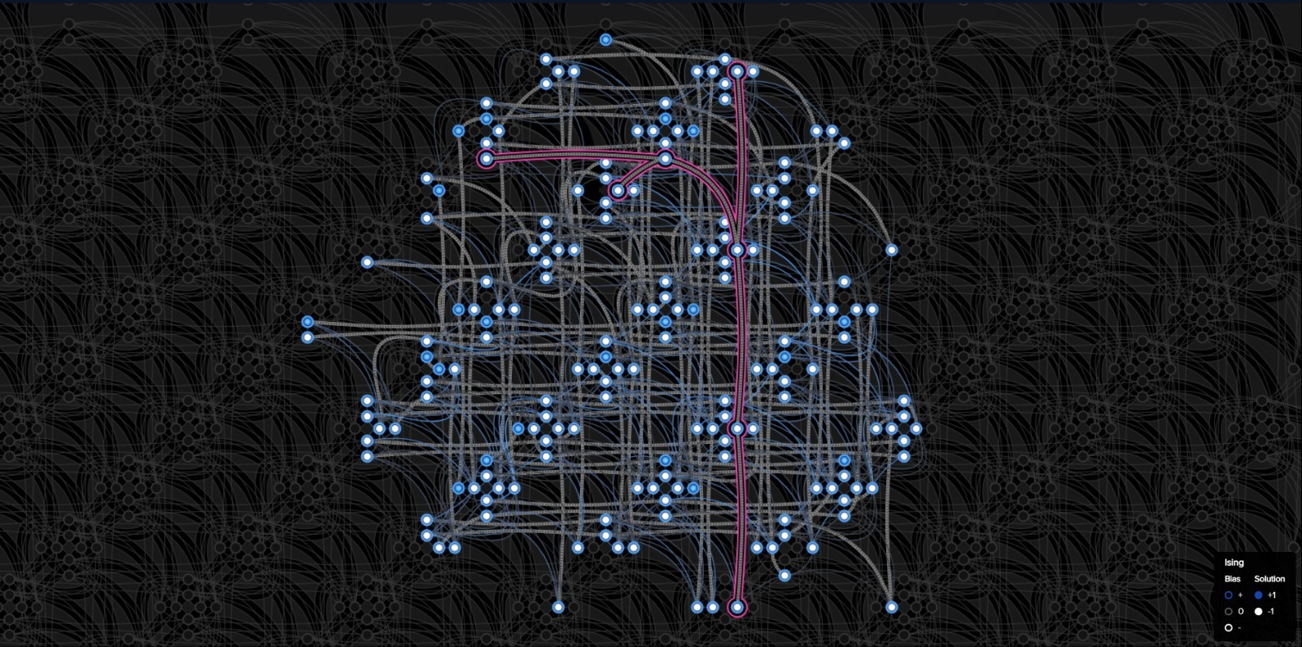
D-Wave Inspector Tool (for n=6)
Darren Lam, Hasham Hussain, Pedro Videira, Xingguang Zhu | Particle Matching | 30

